Slide 1
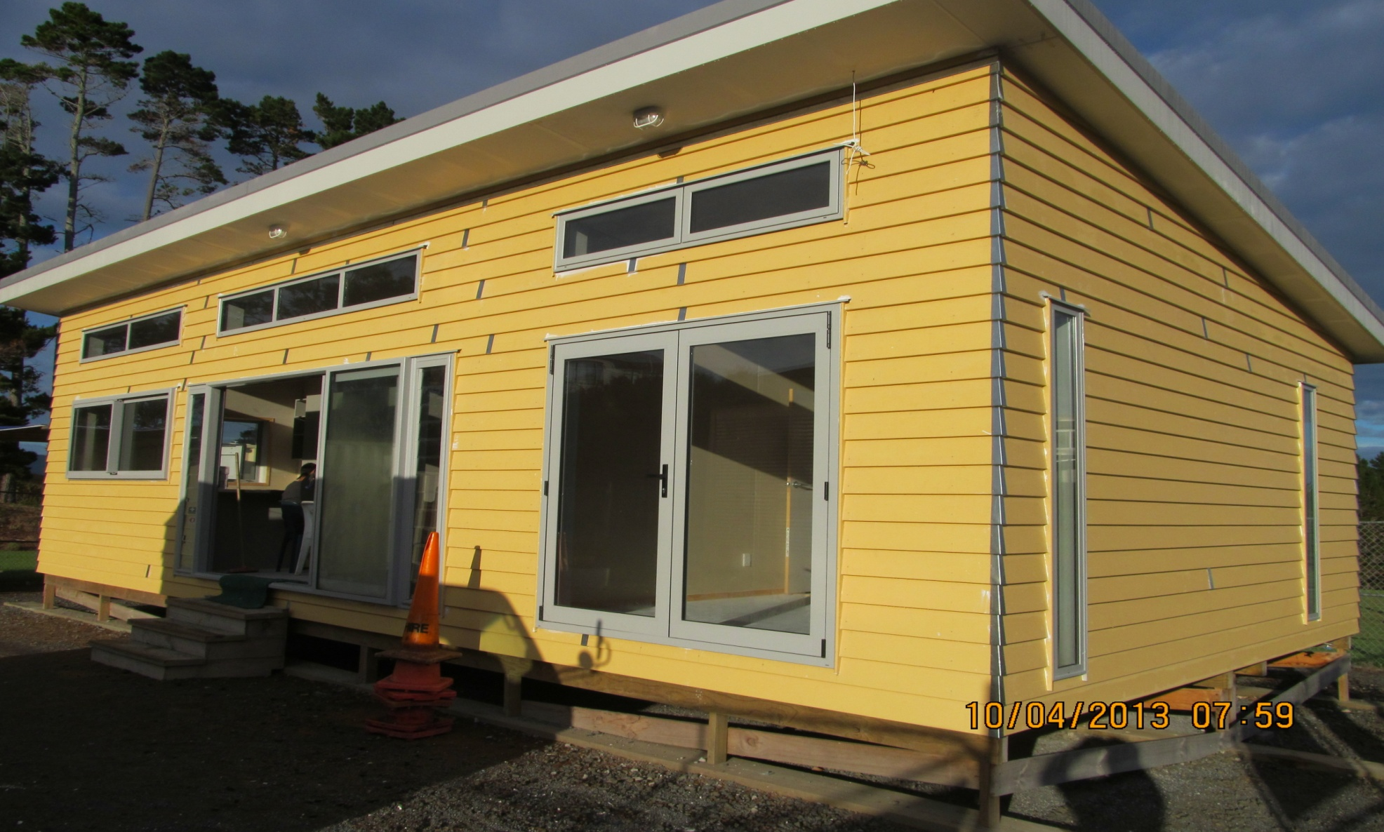
Massey High School Trade Academy

Slide 2
School responsibilities
Massey High School
Teaching theory
Building the house
Educating
Training
Undertaking practical
Provide the facilities
Assisting with house site setup
Provide the teaching staff
Sign off as LBP

Slide 3
Unitec BT responsibilities
Unitec BT
Academic Quality
Plans and Consents for house
Advice
Supervise
Share problem solving
Help with quotations
Help with subbies
Assist with staff and Unitec students at pressure times
Quality Assurance

Slide 4
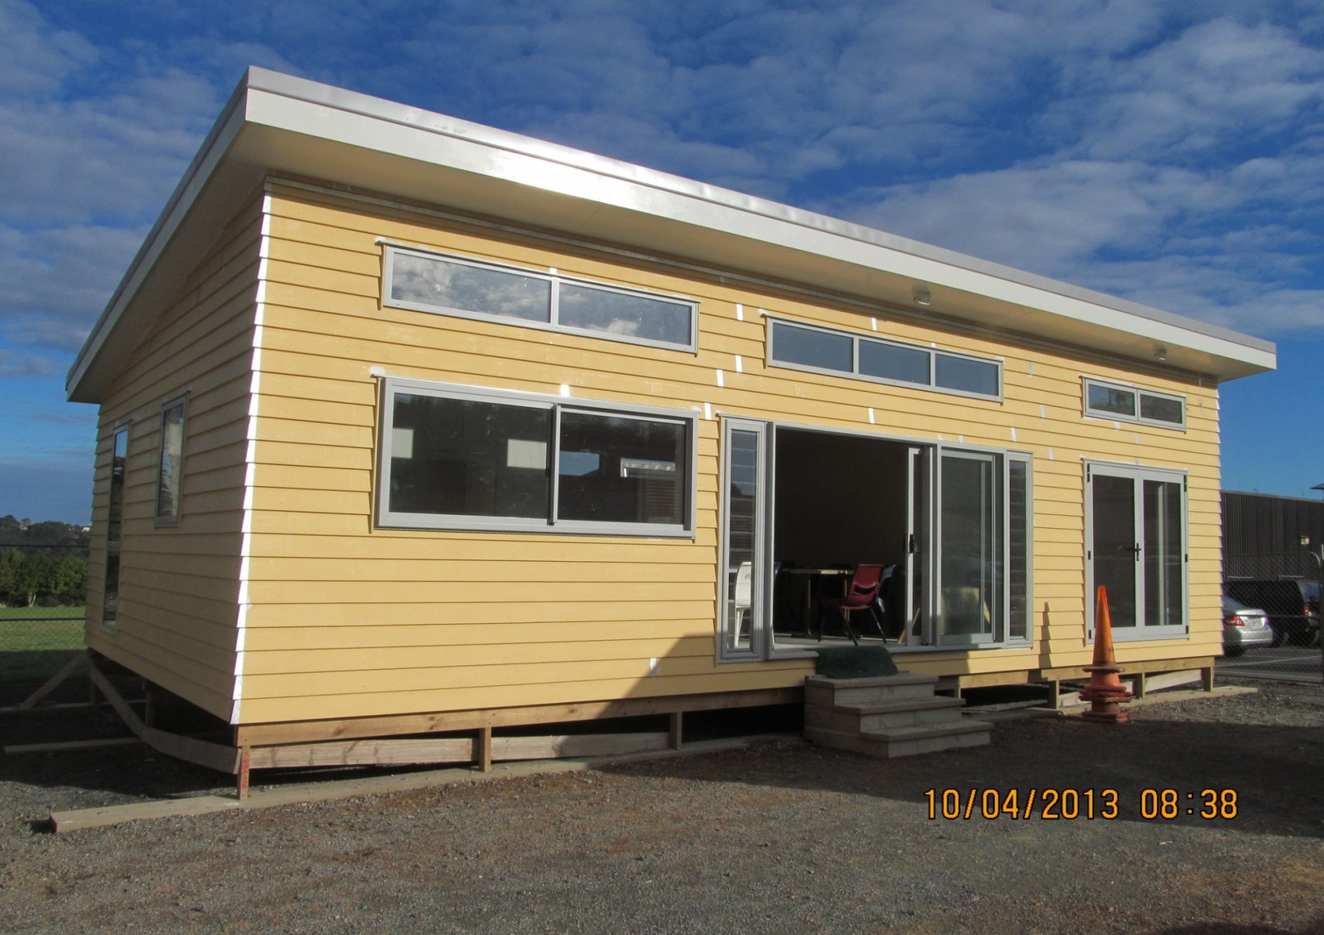
2013 House ready to be moved off-site

Slide 5
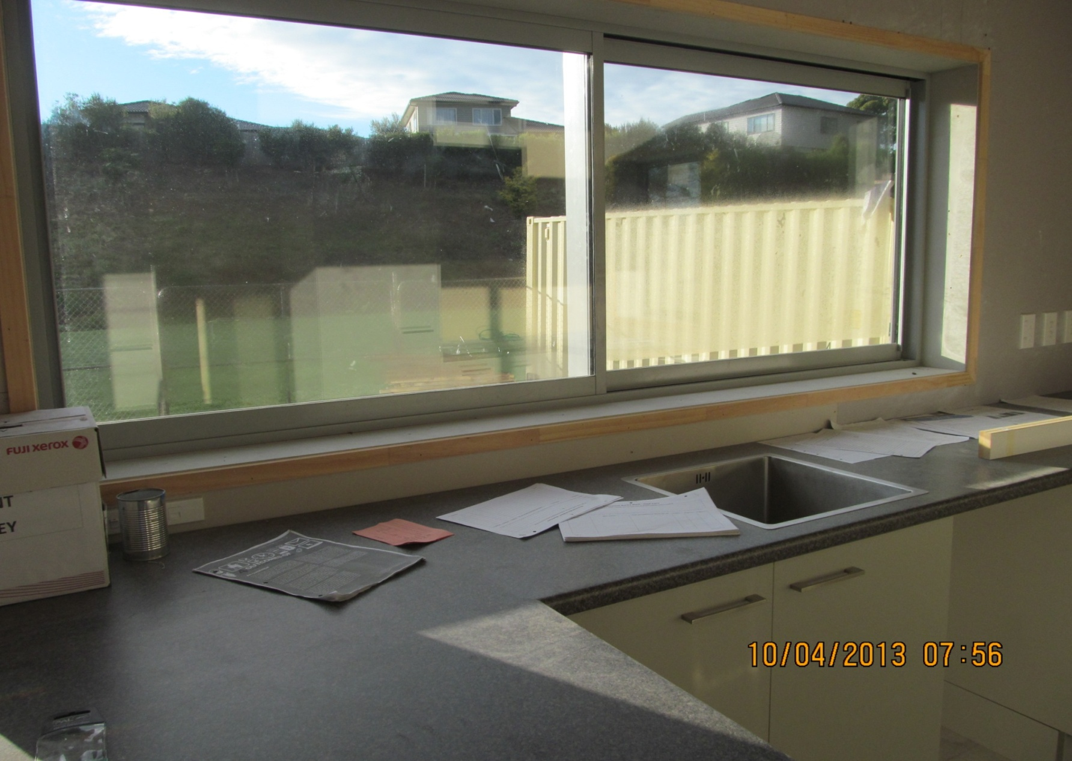
Kitchen view

Slide 6
Reporting diagram (For $’s)
MH School 2013
Housing Foundation
Unitec BT (QA only)
Village Trust
MH School 2014
QA- Unitec
Merchants
MHS now self funds the Building

Slide 7
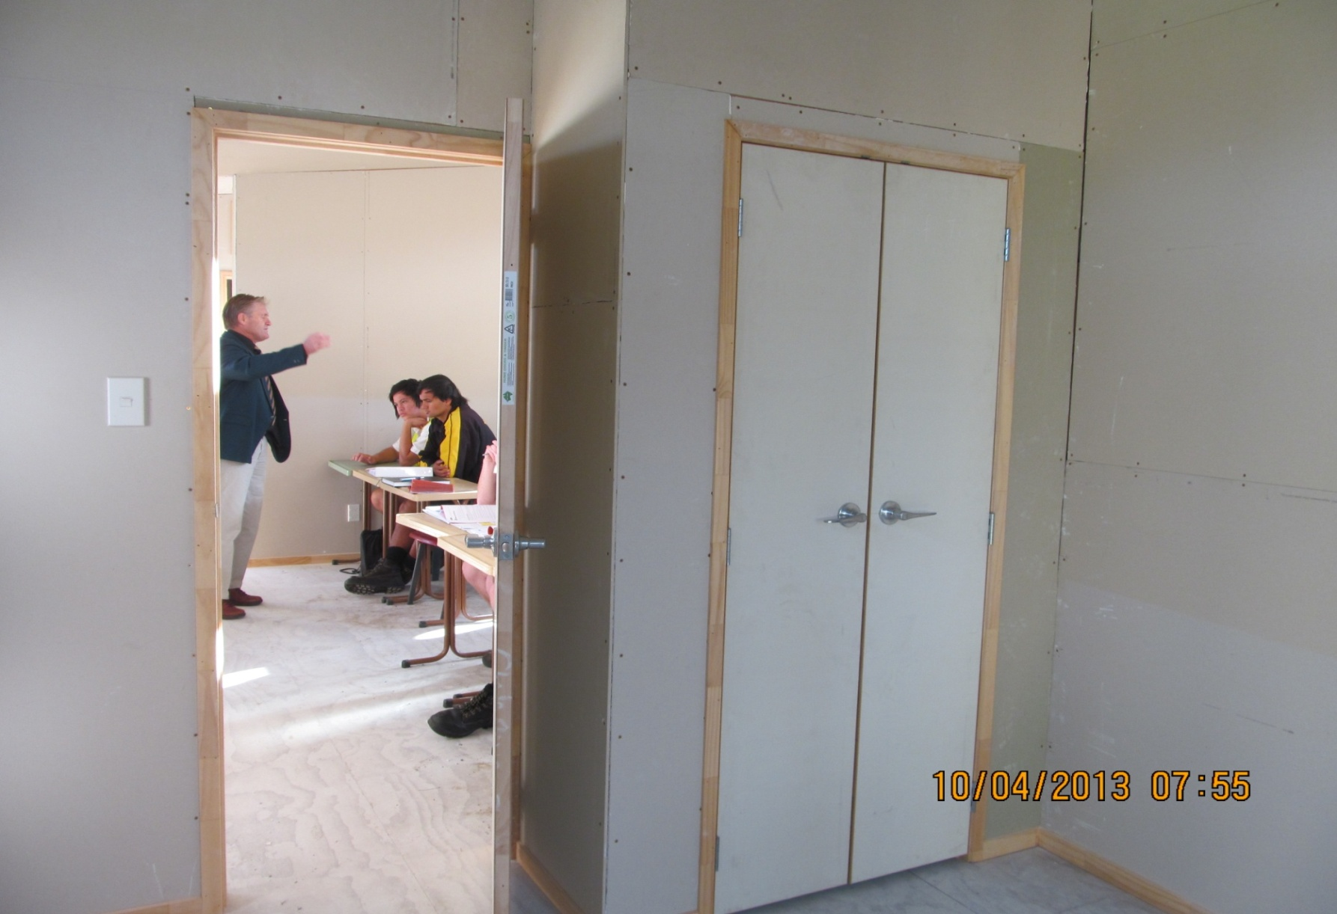
Meanwhile- an on-site classroom for 2014

Slide 8
Programme structure
Theory was done first. BCAT’s used to give the students Level 2 Unit Standards.
Students gained 60 credits at L2 and NCEA L2.
Also, NCC L3 & L4 credits.
Workshop projects undertaken to teach basic skills.
Foundation concrete strips, boxed, reinforced and concreted.
Base plates bolted to that, sub-floor, floor construction from there.

Slide 9
Comments from the Students
I would have dropped out if it hadn’t been for the academy with no L1 or L2 qual’s.
Theory good for understanding.
Safety always important. Toolbox talk every morning during house building. Recorded these.
Real life learning. Tutor acted like a boss! Strict! Late? Run around the field. 10 min warm-up exercises each morning.
Once we got to know the tutor respect came.
Great grounding for further Unitec CAT programme. Step ahead in understanding and experience.

Slide 10
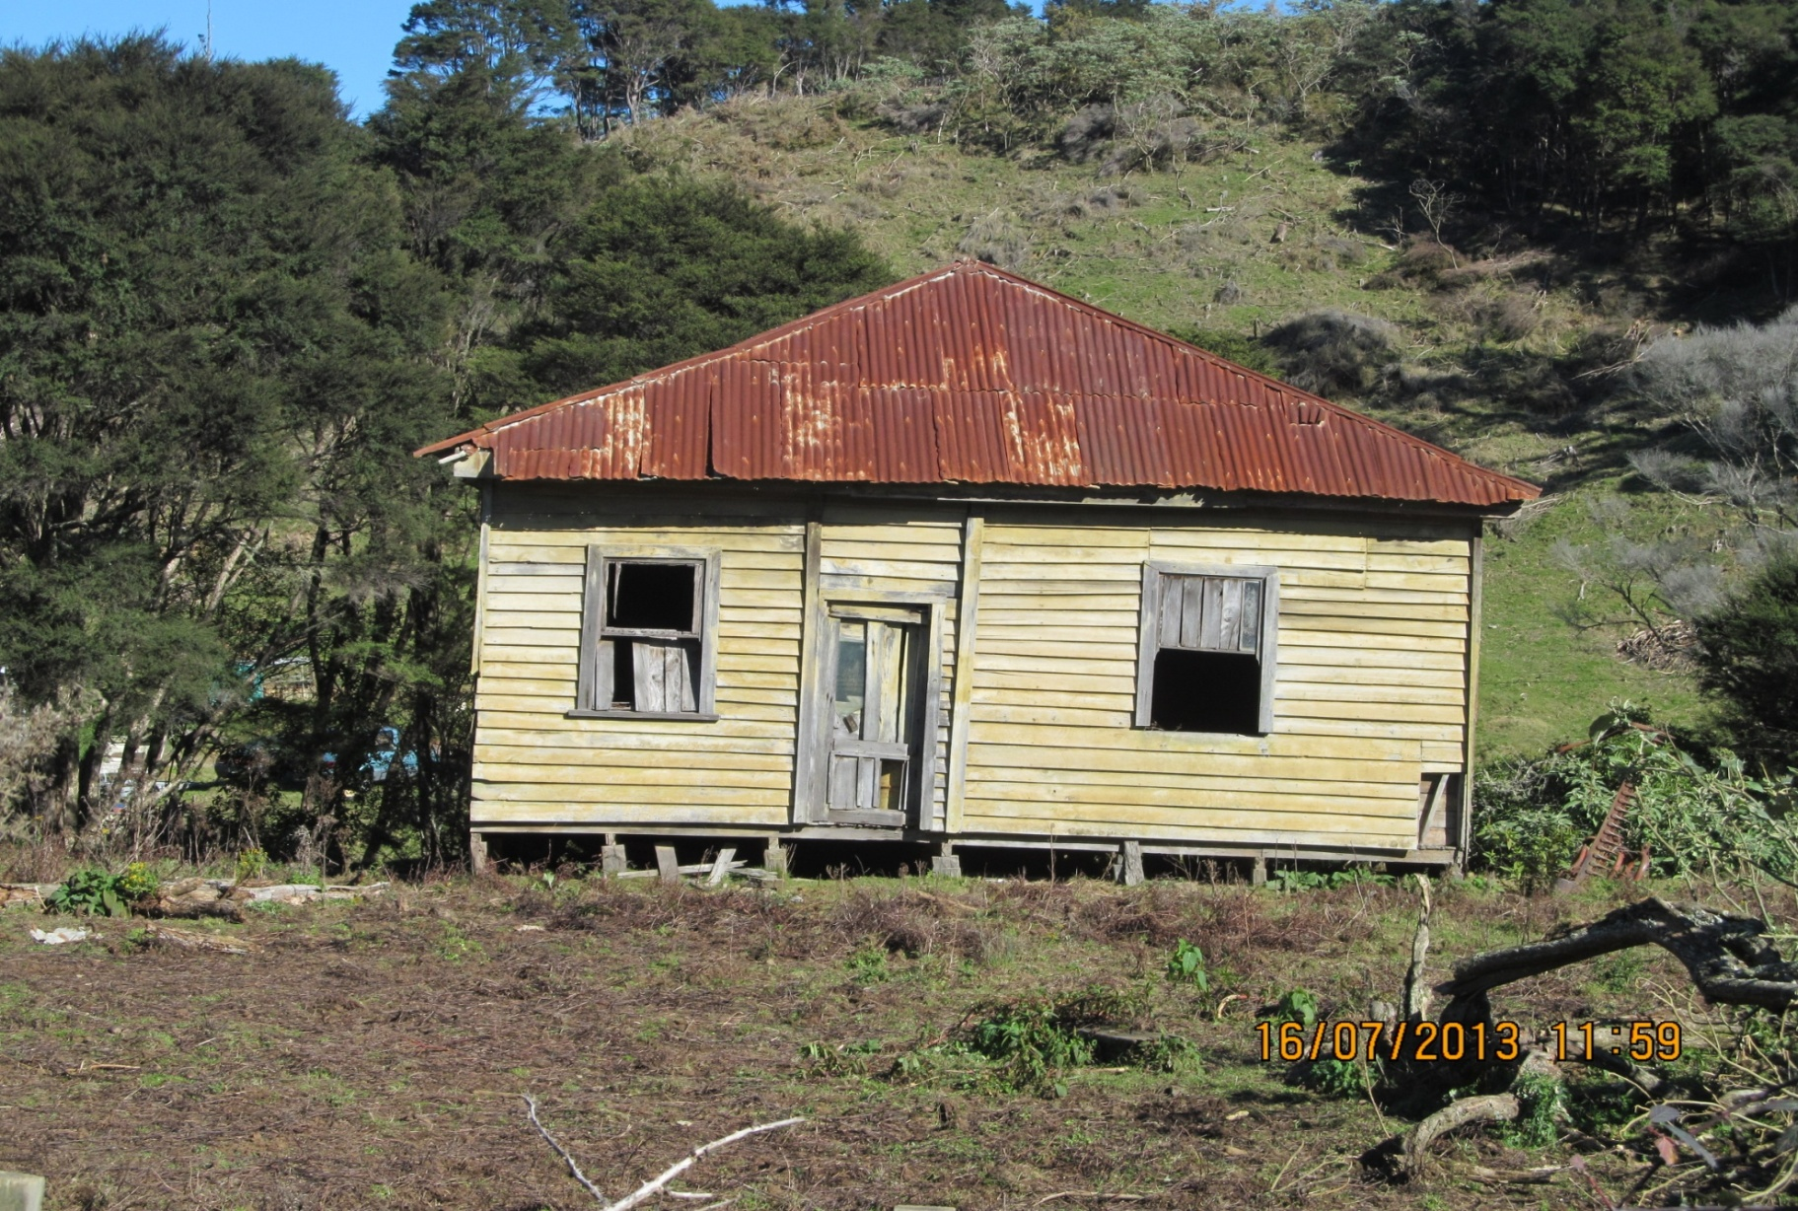
Moved into position- not really

Slide 11
MHS to where? (In 2014)
2 went direct to carpentry apprenticeships.
12 applied to Unitec CAT course,
8 accepted.
1 withdrew.
7 completing
3 have apprenticeships lined up
Others looking (or now have)

Slide 12
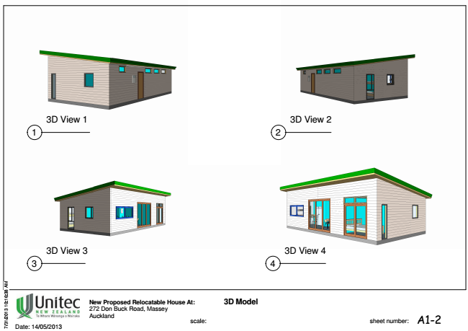
3D model

Slide 13
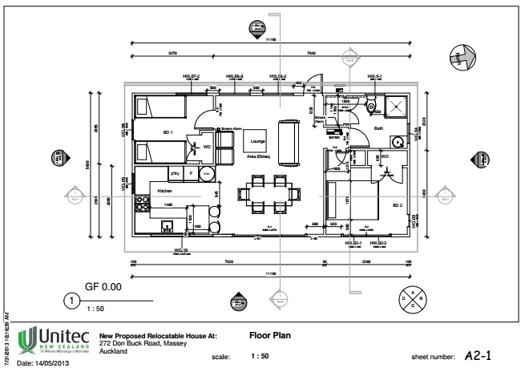
Floor plan

Slide 14
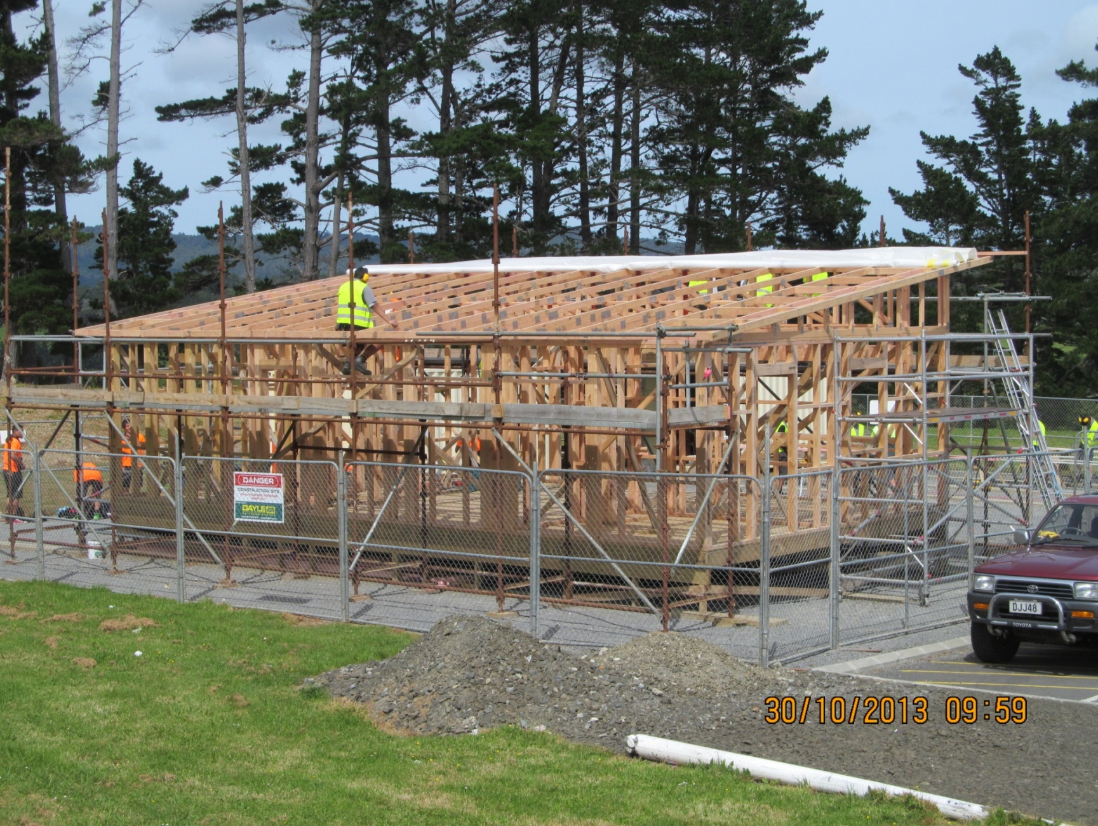
2013 two bedroom 65m2 house

Slide 15
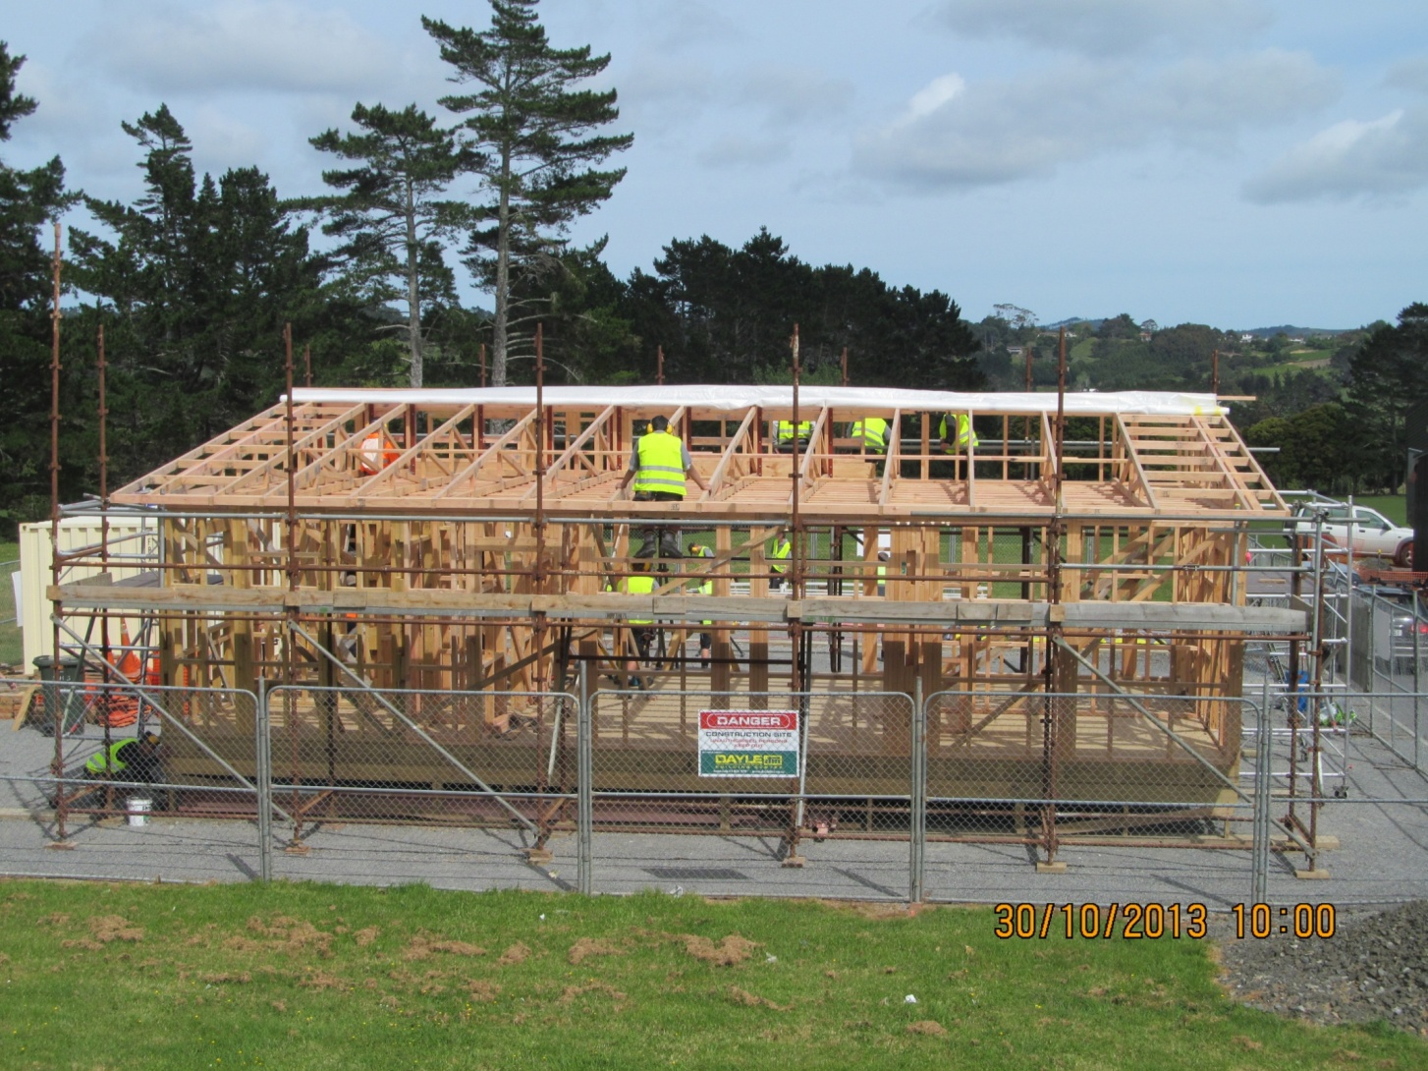
2013 House taking shape

Slide 16
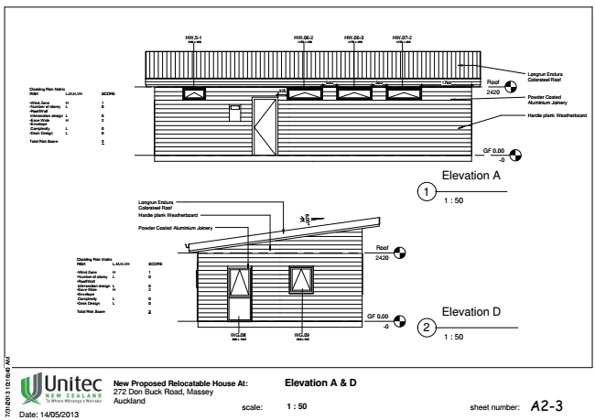
Elevation showing higher windows

Slide 17
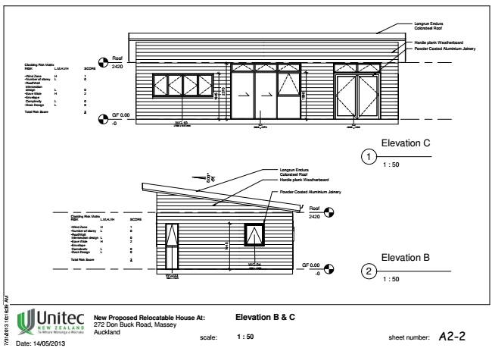
elevations

Slide 18
thankyou
Questions?

